Slide 1
Final Presentation
Team Blue

Slide 2
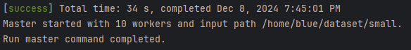
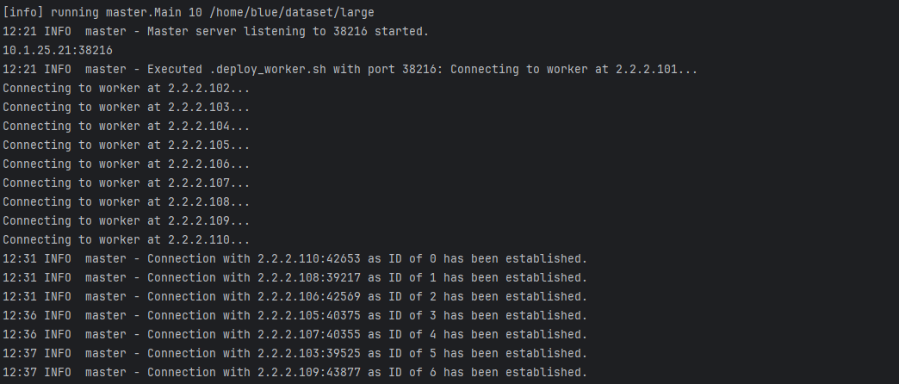
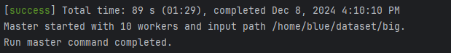
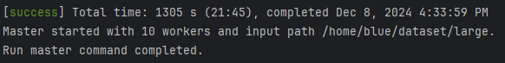
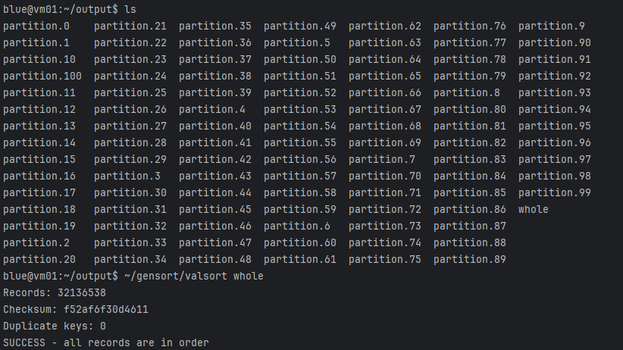
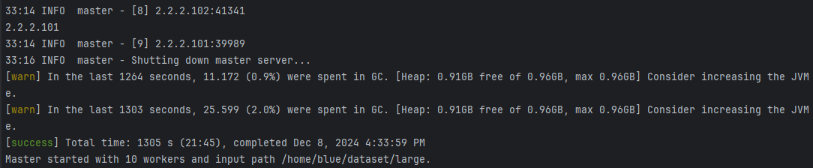
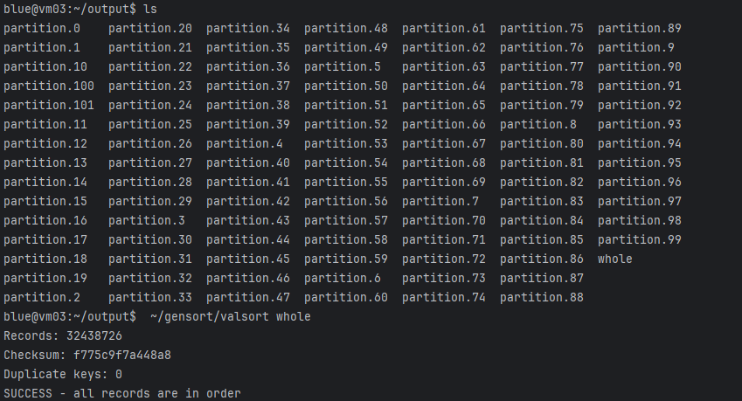
Experimental results using /dataset/{small, big, large}
dataset | Time avg.
Small | 35s
Big | 110s
Large | 1300s
Execution for large dataset
valSort check results example
…

Slide 3
Overall progress
Week 1 Set Git repo. Planning milestones.
Week 2 Learned Concepts and Libraries.
Week 3 Set git Commit convention. Start Overall Design.
Week 4 Assign roles for Chief Programmer, Copilots.
Week 5 Make & Test sample program. Prepare progress presentation.
Week 6 Changes of Overall Design.
Week 7
Completed the overall system implementation (in Local)
Implemented debugging logs
Automated all processes using a shell script
Week 8
Final Test and Debug on VM.
Create a Simple Shell UI
Prepare final presentation

Slide 4
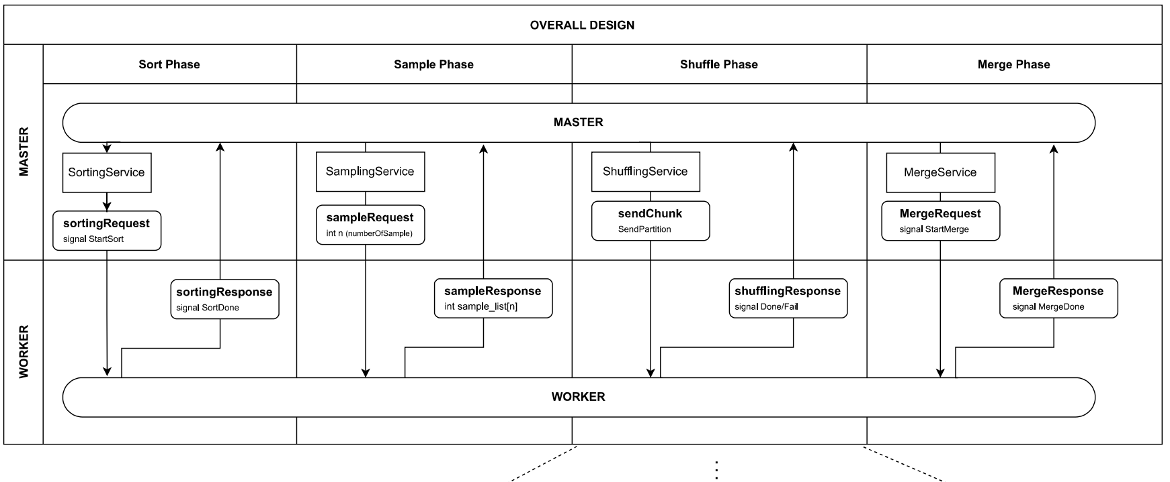
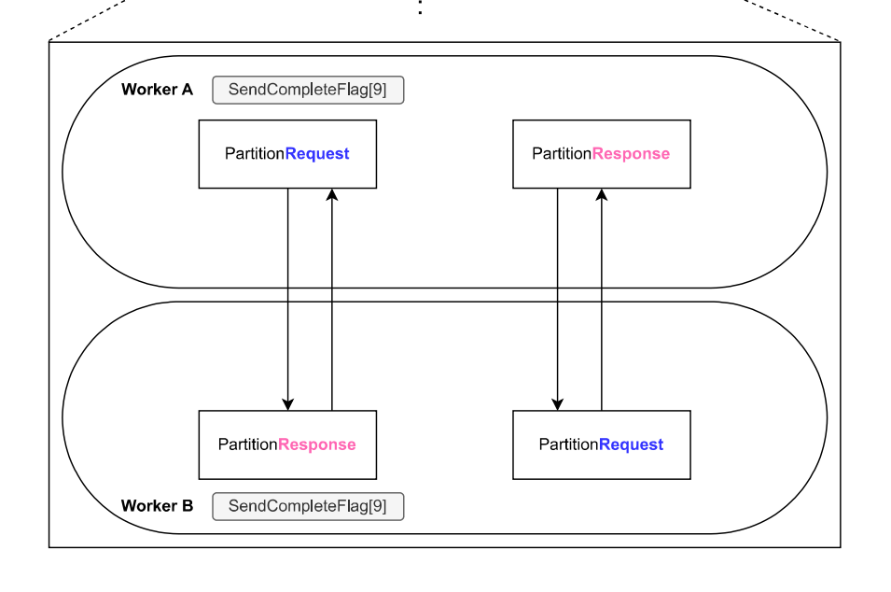
Final architecture of our system
previous design
Phase
MASTER | INITILIZATION | SAMPLING | SORTING | SHUFFLING | MERGING
WORKER
Key Points for Modifications
1) Phase redefined, Service Segmentation
2) When to sort data
3) Add Memory Manager

Slide 5
: Phase
Final architecture of our system
: service
: request message
: response message
INITIALIZATION
SAMPLING
MASTER
server.start()
registerWorker
AllWorkers
[count,workers]
Empty
PartitionAnchors
[anchors]
…
(Master) IP, port
AllocatedID
[id]
SampleRecords
[RecordMessage]
Empty
Empty
WorkerRegisterInfo
[id,ip,port]
WORKER #
server.start()
informOthers
demandSample
sendPartitionAnchors

Slide 6
: Phase
Final architecture of our system
: service
: request message
: response message
MASTER
SORTING
SHUFFLING
MERGING
Empty
Empty
Empty
Empty
Empty
…
Empty
Empty
Empty
Empty
Empty
requestPartition
WORKER#
startSorting
constructFileIndex
startShuffling
startMerging
finish
…
Request:ThidId
Response:PartitionRecords
[RecordsMessages]
…
WORKER#’
requestPartition

Slide 7
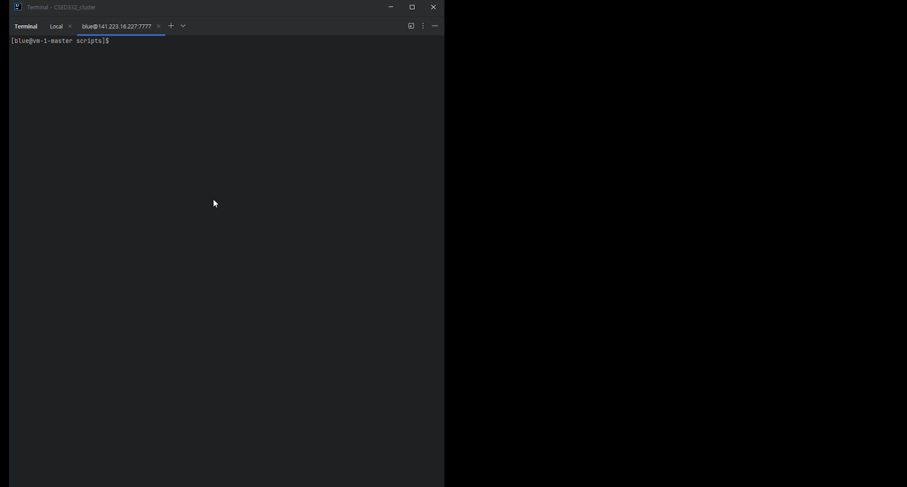
Commands for running master/workers
sbt "runMain master.Main $COUNT"
sbt runMain worker.Main $MASTER_IP:$MASTER_PORT -I $INPUT_PATH -O /home/blue/output/\"

Slide 8
Why our project was successful 1. 역할 및 책임 분담 [Surgical Team Model] 2. Progress presentation을 통한 Feedback Lessons learned from the project 1. Importance of using Diagrams, Tables, etc. in Design Process 2. 추상적인 계획 → 매우 큰 Communication Overhead 발생 e.g. Progress presentation 이후 System 설계 수정 3. Documentation의 중요성 e.g. 팀원이 이미 해결한 문제를, 다른 팀원이 Debugging 요인으로 착각

Slide 9
Lessons learned from the project (Cont’d)
1. ChatGPT 활용에 대한 평가
간단한 빌드 설정 파일 작성에 탁월 (e.g. Makefile, Shell script, Scala 생태계의 build.sbt 작성, etc.)
이름을 짓는 데 뛰어난 능력을 발휘
문제에 대한 정확한 설명 없이 코드를 작성하게 하면 비효율적
남의 코드를 디버깅하는 것보다, 자신의 코드를 직접 디버깅하는 것이 더 효율적
(문제를 명확히 이해하고 설명하더라도) 직접 코딩하는 것이 더 생산적일 수 있음
2. Pure Functional 코드에 대한 논의
유지보수에 유리
일부 상황에서는 명령형 코드가 더 간결하고 직관적

